Slide 1
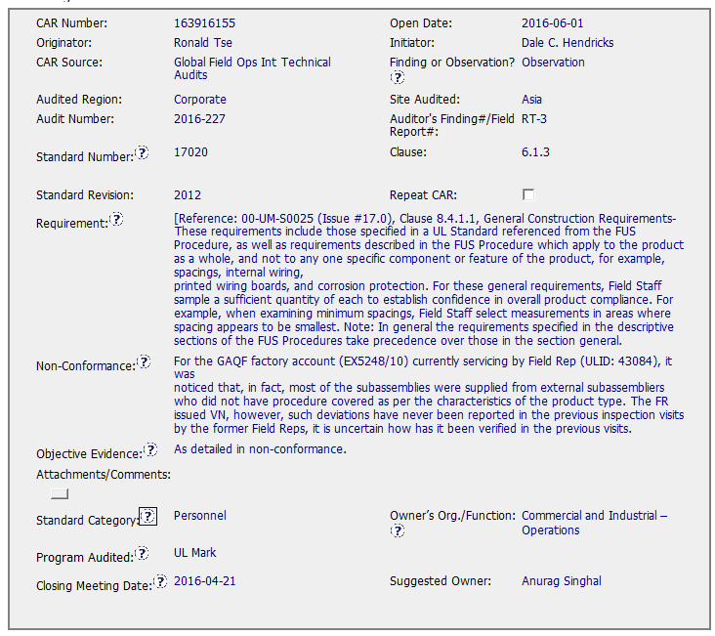
CAR 163916155 - Observation
Although the Requirement is somewhat vague, I felt like I could identify what I needed to see to determine if the objective evidence met the requirement. However, the objective evidence does not appear to directly address the sampling by Field Staff to establish confidence in product compliance. Instead it mentions parts supplied by external subassembliers who did not have procedures covered, the writing of VNs, and the comment that a previous Field Rep did not write VNs.

Slide 2
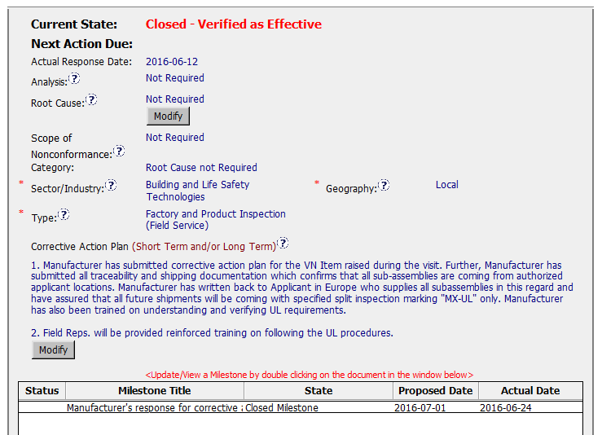
CAR 163916155 - Observation
Corrective Action Plan and LYNC meeting agenda appear to address the VN (Variation Notice?) issue and missing MX-UL inspection marking issue identified in the General Notes
I believe the statement regarding “confirms that all subassemblies are coming from authorized applicant locations” addresses the comment made in the nonconformance that “most of the subassemblies were supplied from external subassemblier who did not have procedure covered…”, but I am not sure

Slide 3
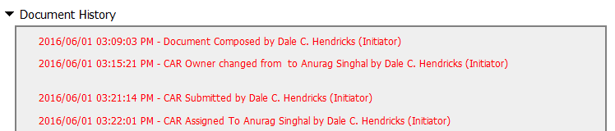
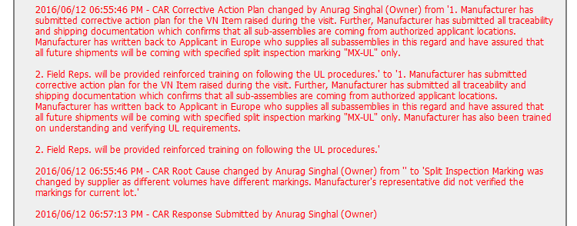
CAR 163916155 - Observation
CAR response submitted prior to 2016-06-15 due date

Slide 4
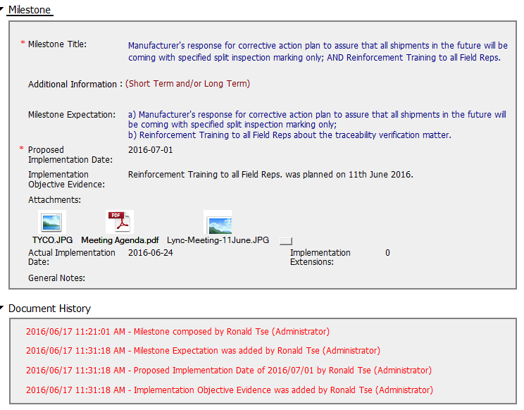
CAR 163916155 - Observation
Admin assisting with documentation and implementation of milestone

Slide 5
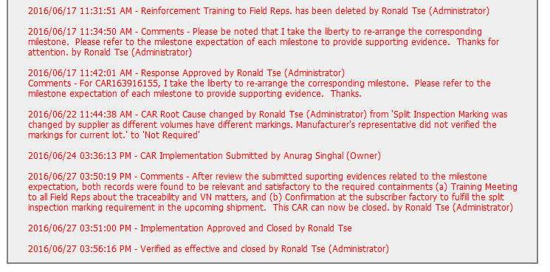
CAR 163916155 - Observation
Comment showing that Admin is communicating changes to owner.
Implementation approved within allowed time and verified immediately

